Slide 1

Shell Bootcamp 2024 3 Reflections for Week #2
Isha Singhal
Date : 06-Sept-2024

Slide 2

About Me
3L’s ( Live life, Learn Lessons and Liberate yourself )

Slide 3

My learnings from this week!

Slide 4
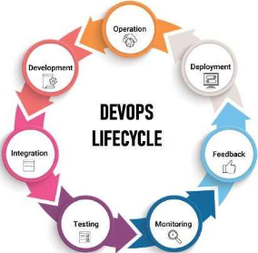
Learning 1 | My takeaways
DevOps
The week started with the knowledge of devops. We came to know what devops is and how it helps in efficient development process.
I learned how to create user stories, epics, test cases and log bugs in Azure DevOps portal.
Automating workflows using Github actions and deploying the project using Github pages was an integral learning for me.

Slide 5
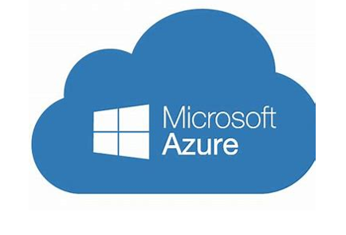
Learning 2 | My takeaways
Azure Cloud
I learned about virtual machines and networks and how azure apps can be used to distribute tasks in a large organization.
I learned how they are useful in a business as hardware resources can easily be rented from providers instead of being bought dircty which can be expensive.
Due to expense and bulkiness of server machines, it is beneficial to link up with service providers to meet the growing IT needs of energy industries

Slide 6
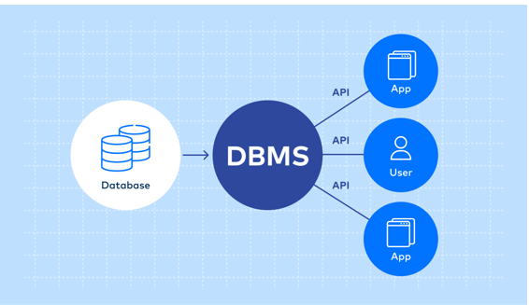
Learning 3 | My takeaways
DBMS
DDL(Data Definition Language), DQL(Data Query Language), DML(Data Modification Language), and Transactions.
Data Integrity: Ensuring data accuracy and consistency through transactions.
Efficiency: Efficient data manipulation and querying using DML and DQL.
Structure: Proper database structure and schema design using DDL.

Slide 7

Relevance of learnings for my organization

Slide 8
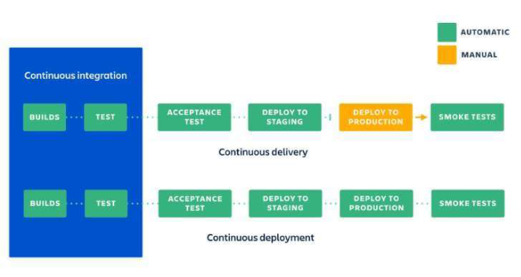
Learning 1 | Relevance for Shell
DevOps
Agile and DevOps Integration: Shell has integrated agile methodologies with DevOps practices.
Automation: Shell uses automation extensively to streamline their CI/CD pipelines, ensuring faster and more reliable software delivery.
Collaboration: Enhanced collaboration between development and operations teams is a cornerstone of Shell’s DevOps strategy, fostering a culture of continuous improvement and innovation.
[Add a graphic that provides view of how Shell implements this learning]

Slide 9
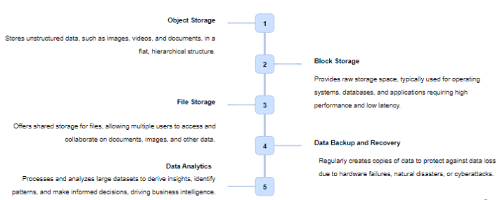
Learning 2 | Relevance for Shell
Cloud
Cloud Migration: Shell has migrated its subsurface data and workflows to cloud-based platforms to boost collaboration and innovation2.
Hybrid Cloud: Shell utilizes a hybrid cloud approach, combining public and private cloud resources to optimize performance and cost-efficiency.
Data Integration: The migration to cloud-based platforms has enabled Shell to integrate data across various disciplines, improving efficiency and decision-making.

Slide 10
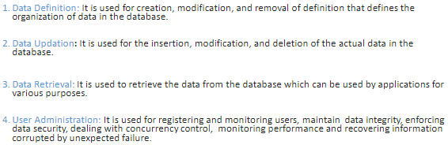
Learning 3 | Relevance for Shell
DBMS
Unified Data Platform: Shell has developed a Unified Data Analytics Platform to integrate data across the company, enhancing efficiency and decision-making.
Data Management: Shell uses various DBMS technologies to manage and analyze large volumes of data, ensuring data integrity and accessibility.
Transaction Management: Ensuring data integrity through ACID (Atomicity, Consistency, Isolation, Durability) properties in transaction management.

Slide 11

Challenges in implementing learning

Slide 12
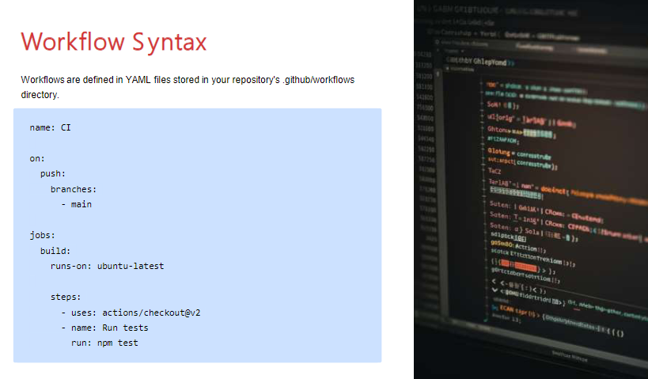
Challenge faced while implementing Learning 1
Challenges Faced in DevOps:
YML file Integration: Integrating various technologies into a cohesive CI/CD pipeline can be complex.
[Add a graphic that provides evidence of what you did to overcome this challenge]

Slide 13
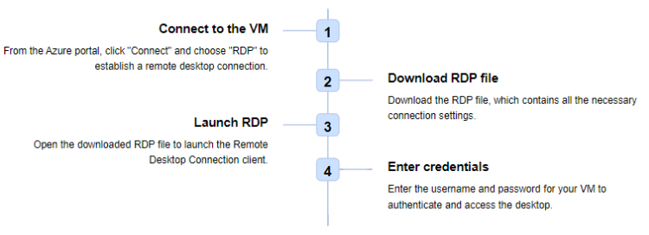
Challenge faced while implementing Learning 2
Challenges face in Cloud:
Creation of Virtual Machine came with a lot of difficulty and issues.

Slide 14
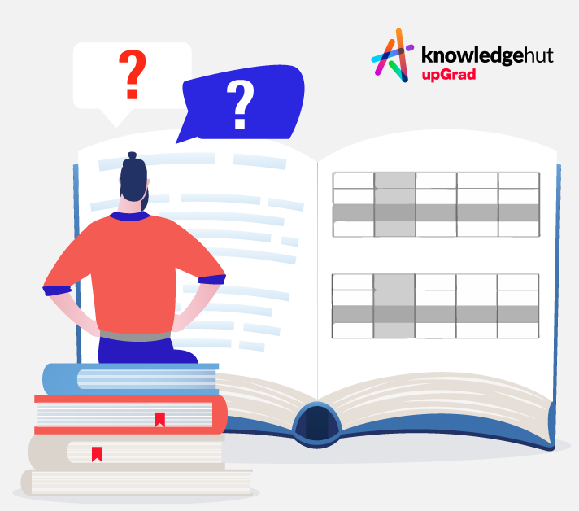
Challenge faced while implementing Learning 3
Challenges faced in DBMS:
Complex Queries: Writing and optimizing complex SQL queries to handle large datasets.

Slide 15

Action Plan

Slide 16
My Action Plan for this Week
Actions
Timeline
Status
Will use the knowledge gained from here in my work and get proficient in it.
2 weeks around
Will get more proficient and comfortable with these technologies

Slide 17

Learning is also Fun!

Slide 18

Learning is also Fun!
Doing group activities such as making user stories, epic, bugs, test cases together helped me understand the concept more easily and made the learning fun as well

Slide 19

Summary
Learnt many new technologies and tools used in IT such as azure which included Virtual Machine creation in different available zones, azure DevOps which involved creation of epic, user story, tasks, test cases, bugs. Also included DBMS which introduced me to various queries and schematic relations.

Slide 20
Thank You

